Slide 1
FINAL PROJECT

Slide 2
THREAT SUMMARY
Summary of Situation: In A, B, and C hospitals, a message has popped up that indicates that all the personal files are encrypted by the attacker and will only be decrypted and released when they pay some ransom in Bitcoin(BTC), so that its untraceable. It is indicated that the incident has started with a user in the technology department opening an email attachment resource. This incident has not yet been seen in Hospital X.
Asset: Patient Records, Medical Systems, Control Systems for monitoring Patients, Log analysis tool, Windows systems containing centralized log files and backups, Personal Documents
Impact: Confidentiality, Integrity and Availability.
Threat Actor:
External threat actors – An attacker (cyber-criminals) that carried out an attack for financial reasons.
Internal Threat Actor(Potential) - Could be the employee that opened the email attachment with an intention to cause harm and is financial motivated.
Threat Actor Motivation: Cybercriminals who are financially motivated, which in this case (FIN4), seems to be main reason as they are demanding huge amount of money. Employees who are unhappy with the organization and seek to retaliate often through digital resources and exploitation. There could also be individuals who are terminated but steal data as they are leaving or have access after their separation from the company.
Common Threat Actor Techniques:
Intentional Threats – Techniques like Phishing, Spear Phishing used by attackers to acquire sensitive data through an email attachment
Unintentional threats – Could be caused by victims like the employees who are unaware about digital security threat and are victims to social engineering.

Slide 3
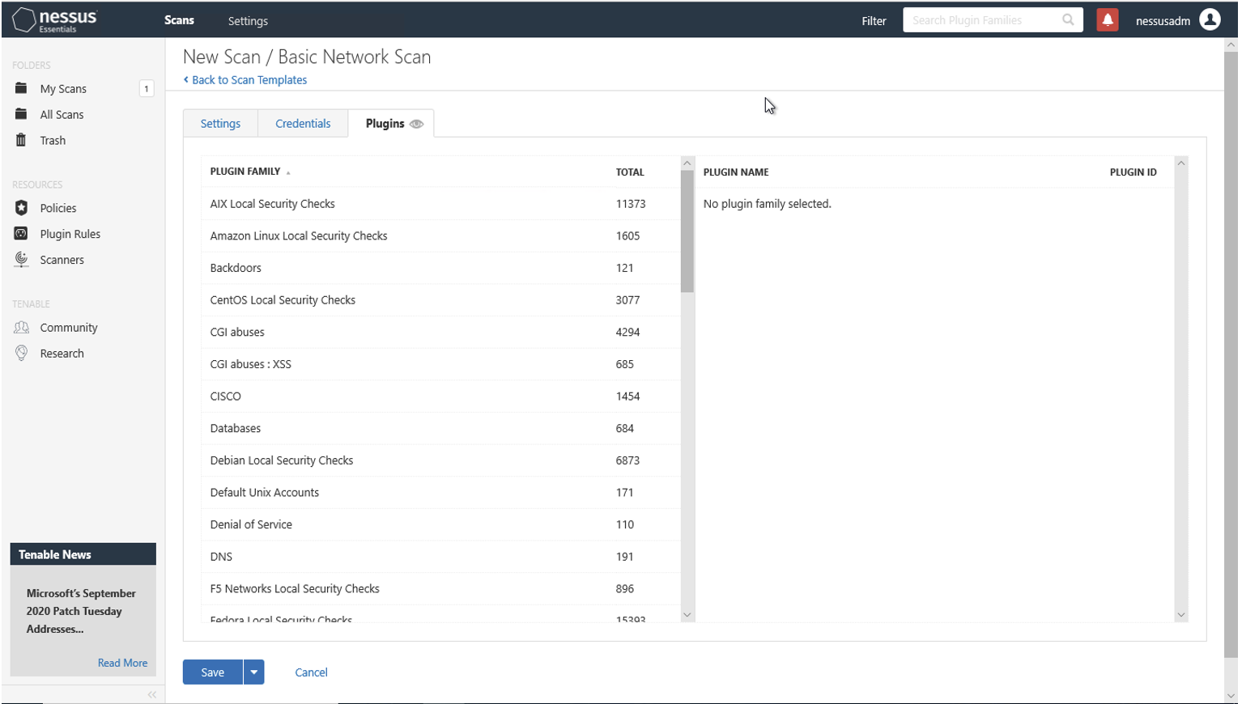
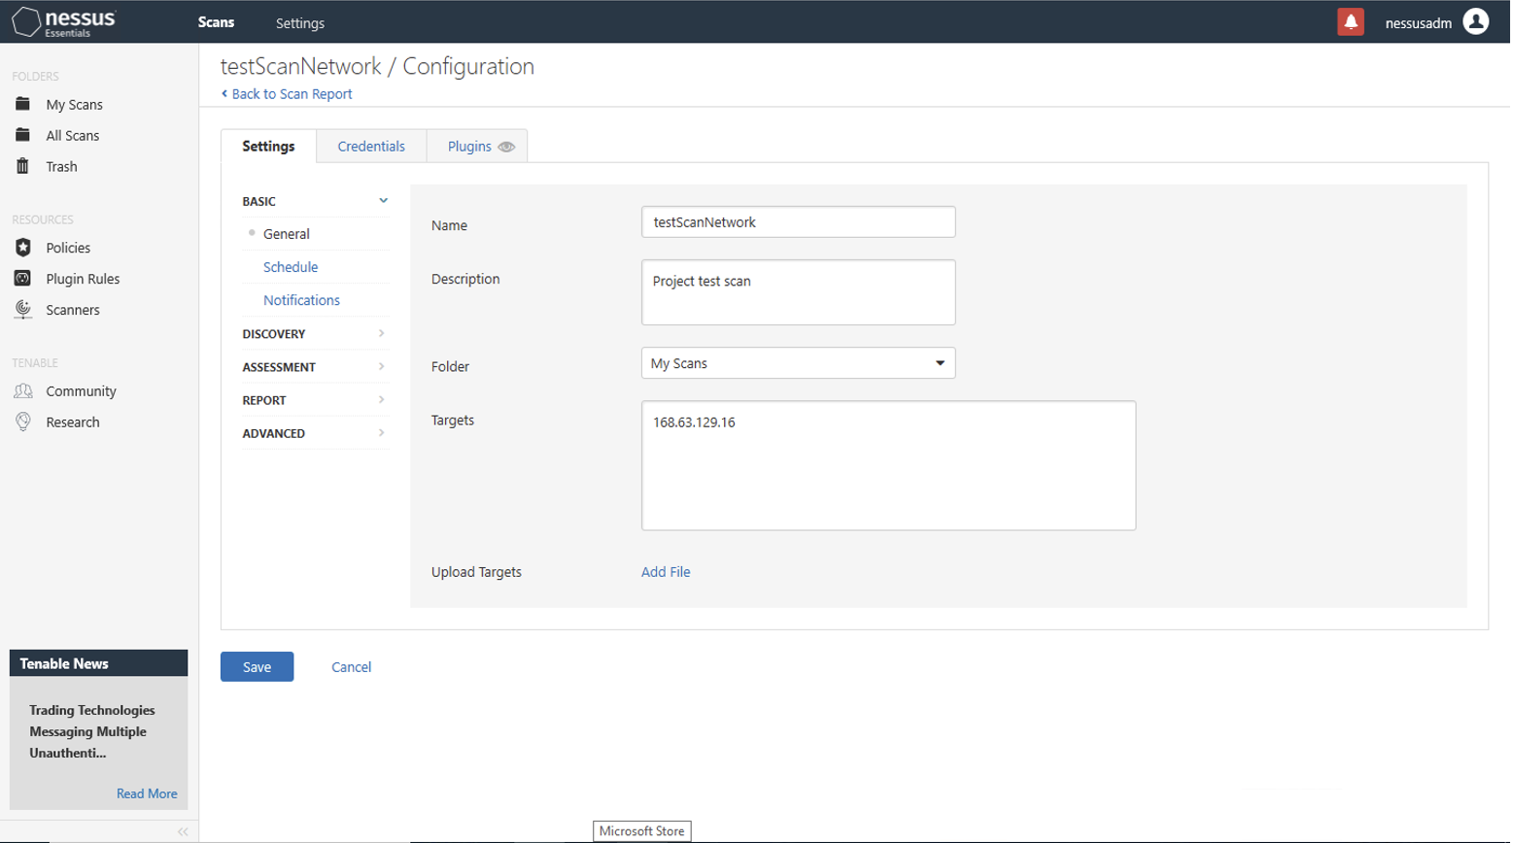
VULNERABILITY SCANNING TARGETS
Summary of scan targets:
Number of devices scanned: 1
Device type: Virtual Machine (General Purpose)
Primary purpose of device: General purpose computer

Slide 4
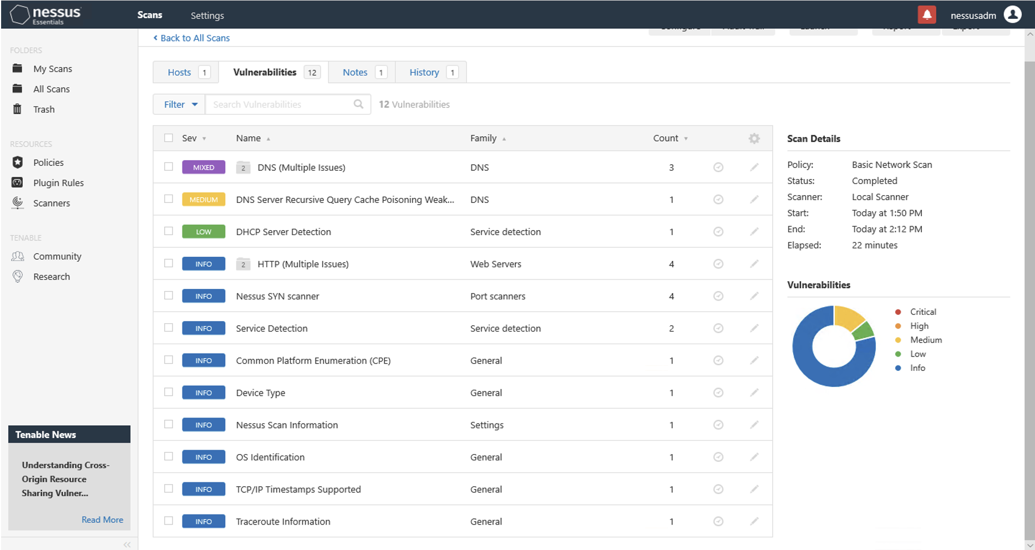
VULNERABILITY SCAN RESULTS
Summary of findings:
Total number of actionable findings:
Critical: 0
High: 0
Medium: 1
Low: 1

Slide 5
REMEDIATION RECOMMENDATION
Fix within 7 days
Finding | Severity Rating | Recommended Fix
No Critical or High Vulnerabilities found
Fix within 30 days
Finding | Severity Rating | Recommended Fix
DNS Server Spoofed Request amplification DDoS | Medium | From public network restrict access to your DNS server or reconfigure it to reject such queries
DNS Server Recursive Query Poisoning Weakness | Medium | Restrict recursive queries to the hosts that should use this nameserver
Prioritization Notes:
(Summarize your thought process for how you organized these here)
Fix within 60 days
Finding | Severity Rating | Recommended Fix
DHCP Server Detection | Low | Apply filtering to keep this information off the network and remove any options that are not in use

Slide 6
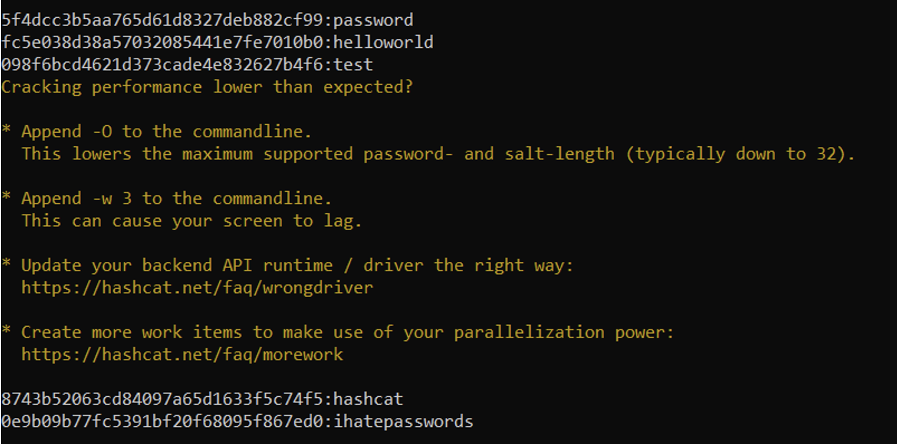
PASSWORD PENETRATION TEST OUTCOME
Methodology: Place all the hashed passwords in a text file. Download a password list (here I named it rockyou). Open command prompt and type the command hashcat –m (is the hash type) –a (attack mode) and the hashfile and masked file with the rule at the end.
Number of passwords tested: 44
Number of passwords cracked: 5
Evidence of weak passwords: 5
Recommended steps to improve passwords security:
Use passwords which are at least 8 characters long. Passwords need be changed every 90 days. Passwords need to be a combination of digits, special and alpha numeric characters

Slide 7
INCIDENT RESPONSE PRELIMINARY ASSESSMENT
Summarize ongoing incident:
What do you know so far?
An assault has befallen wherein all of the private files are encrypted by the attacker. The attacker has demanded to pay 1 million dollars in bitcoins in order to get back the files. The personnel (Doctors, nurses and administrative staff have no access to the control systems that are used to monitor patient stats. Doctors aren't capable of render remedies because the precise records and the patient status is not available. The log analysis tool is not accessible and there is a critical security incident declared.
Document actions or notes from the following steps of the initial incident response checklist
Step 1: Gather a team of professionals who can deal with cybersecurity problems.
Step 2: Find how the was the attacked encountered and by whom – user in the technology department opening an email attachment resource. Category of incident is phishing
Step 3: Try to restore servers and files from the backups
Step 4: Search for the source of the incident
Step 5: Contain and isolate the source of the incident
Step 6: Plan a strategy to avoid paying ransom
Step 7: Once the incident is over conduct proper cybersecurity training to all the staff members.
Step 8: Conduct regular backups.

Slide 8
INCIDENT RESPONSE RECOMMENDED ACTION
Summarize recommendation to contain, eradicate, and recover:
Describe the overall recommended containment, eradication, and recovery plan
The source of the incident must be found, and the email attachment must either be deleted or isolated. Once this is done, the files and servers need to be restored using the backups. As the attacker has mentioned, we can delete the software. Once it is deleted all the remaining traces of the software must also be erased.
The severity of this incident is high. The medical staff is unable to treat patients as the information is not available. This might cause loss of patient life. In order to avoid such incidents in the future, there must be regular information sessions for the staff. The session must contain what the staff should do and what they shouldn’t. Regular data and server backups must be conducted so that the data is available even if there is any problem.
Documented actions and notes from the IR checklist
Step 7: Perform procedures such as Malware response, Insider threat or Denial of service response.
Step 8: Check the system activity and determine if the cause of the incident was intentional or unintentional.
Step 9: Make sure all the systems are patched and backups are in place.
Step 10: Document the incident, cause, impact, risk score, steps taken to overcome it, what steps needs to be followed etc.
Step 11: Have a proper planning mechanism until the incident is solved and also for future.

